Slide 1

MULTIVARIATE TIME SERIES
Seminar
Team-4
Joel gigu (2248108)
Jesto peter (2248107)
Nishanth girish (2248111)
Amala ann Mathew (2248121)

Slide 2
INTRODUCTION
What is time series?
What is an univariate time series?
What is a multivariate time series?

Slide 3
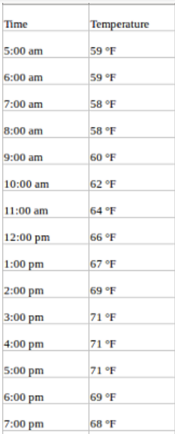
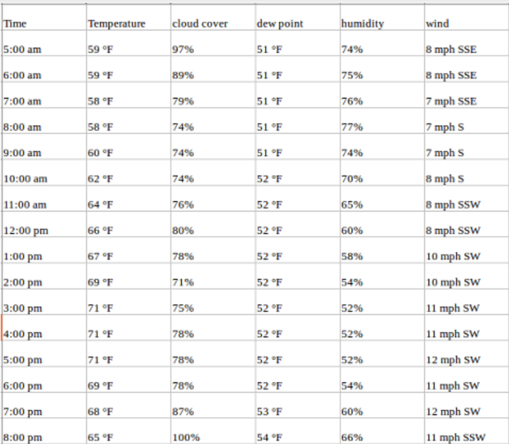
EXAMPLES:
The data on the right is an example of a multivariate time series
The data on the left is an example of an univariate time series.

Slide 4
Few commonly used models in multivariate time series:
Vector Autoregression (VAR)
Vector Moving Average (VMA)
Vector Autoregressive and Moving Average (VARMA)
Vector Error Correction Model (VECM)
Dynamic Factor Models (DFM)

Slide 5
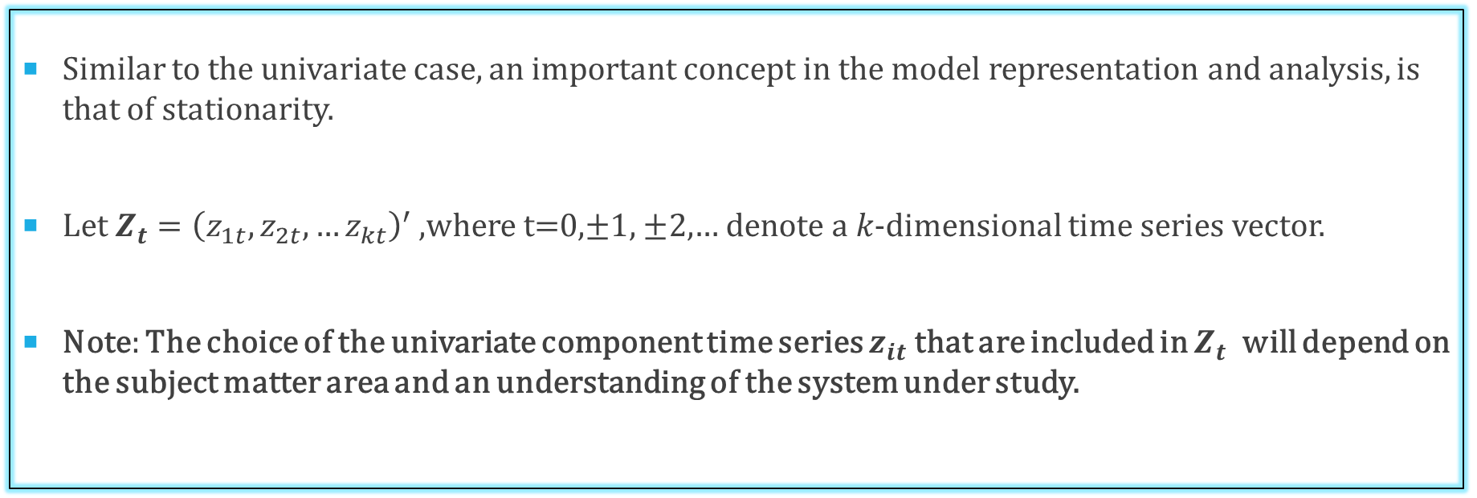
Stationarity in Multivariate Time Series
Similar to the univariate case, an important concept in the model representation and analysis, is that of stationarity.
Let $Z_{t}={\left(z_{1t},z_{2t},…z_{kt}\right)}^{′}$ ,where t=0,$±1,$ $±2,$… denote a 𝑘-dimensional time series vector.
Note: The choice of the univariate component time series $z_{it}$ that are included in $Z_{t}$ will depend on the subject matter area and an understanding of the system under study.

Slide 6
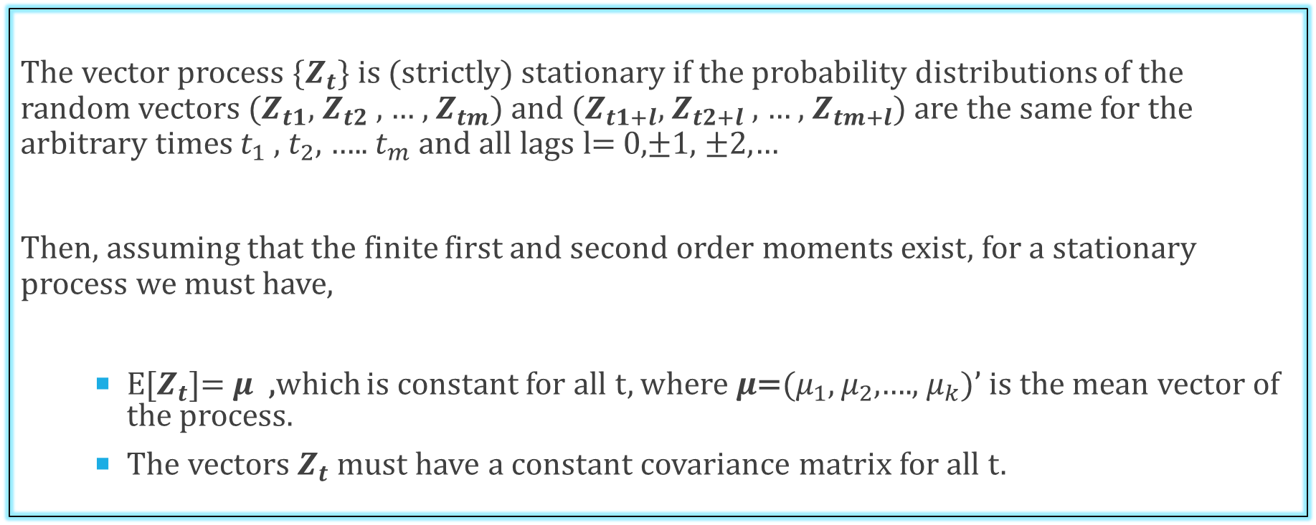
Strictly Stationary
The vector process {$Z_{t}$} is (strictly) stationary if the probability distributions of the random vectors ($Z_{t1}$, $Z_{t2}$ , … , $Z_{tm}$) and ($Z_{t1+l}$, $Z_{t2+l}$ , … , $Z_{tm+l}$) are the same for the arbitrary times $t_{1}$ , $t_{2}$, ….. $t_{m}$ and all lags l= 0,$±1,$ $±2,$…
Then, assuming that the finite first and second order moments exist, for a stationary process we must have,
E[$Z_{t}$]= $μ$ ,which is constant for all t, where $μ$=($μ_{1}$, $μ_{2}$,…., $μ_{k}$)’ is the mean vector of the process.
The vectors $Z_{t}$ must have a constant covariance matrix for all t.

Slide 7
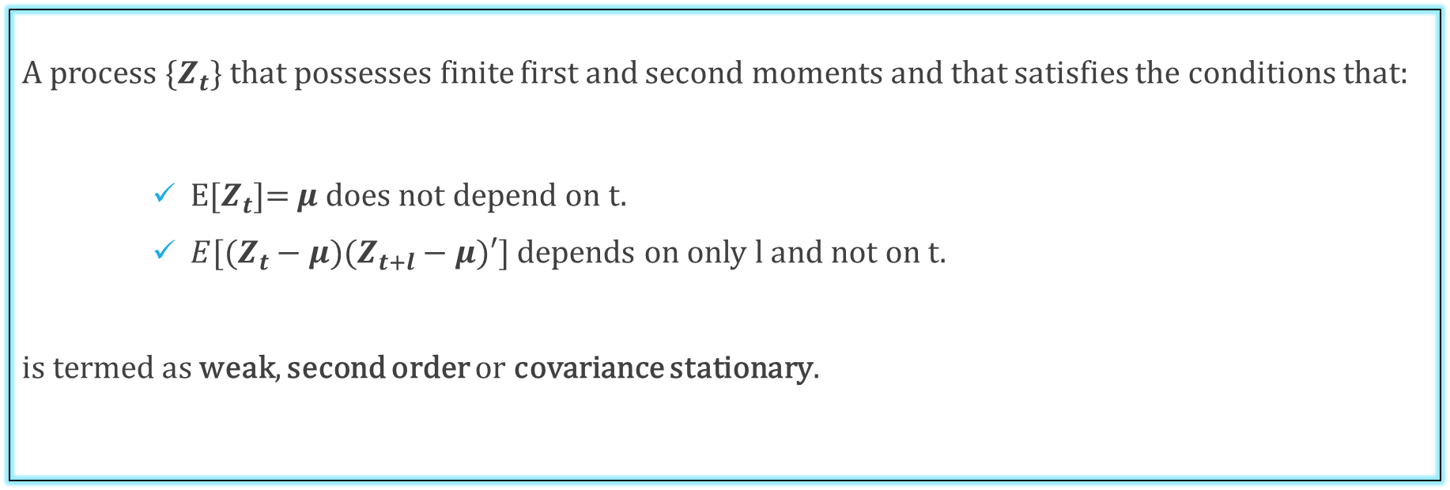
Weakly Stationary
A process {$Z_{t}$} that possesses finite first and second moments and that satisfies the conditions that:
E[$Z_{t}$]= $μ$ does not depend on t.
$E[(Z_{t}−μ)(Z_{t+l}−μ)′]$ depends on only l and not on t.
is termed as weak, second order or covariance stationary.

Slide 8
Assumption Of Weak Stationary
In multivariate time series analysis, weak stationarity is typically assumed instead of strong stationarity because strong stationarity is a much stronger assumption that may not be satisfied in many practical applications.
The assumption of strong stationarity may not hold in many real-world situations where the underlying processes generating the time series are subject to various changes and disturbances.

Slide 9
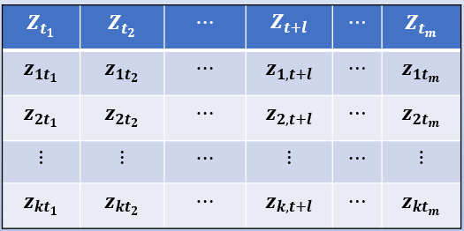
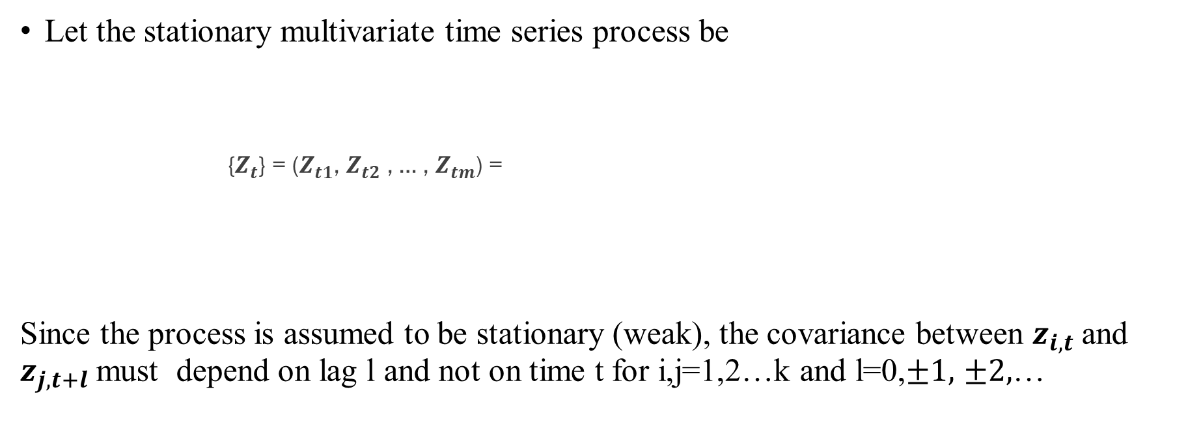
Cross-Covariance & Cross-Correlation Matrices
Let the stationary multivariate time series process be
{$Z_{t}$} = ($Z_{t1}$, $Z_{t2}$ , … , $Z_{tm}$) =
Since the process is assumed to be stationary (weak), the covariance between $z_{i,t}$ and $z_{j,t+l}$ must depend on lag l and not on time t for i,j=1,2…k and l=0,$±1,$ $±2,$…

Slide 10
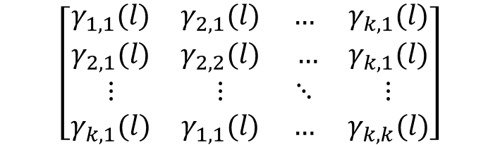
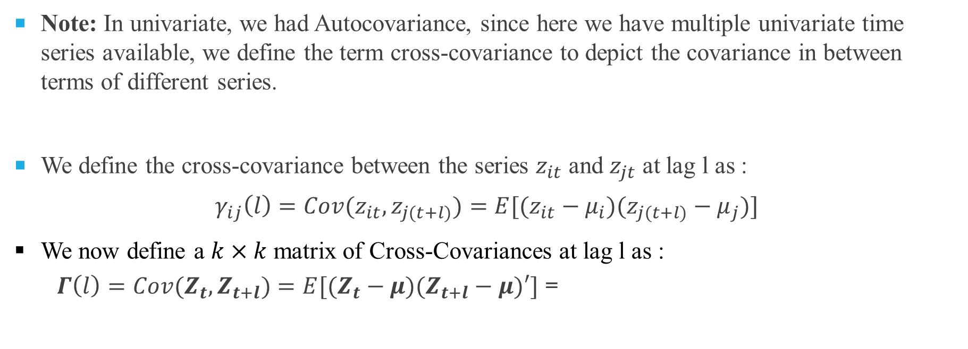
Cross-Covariance Matrix
Note: In univariate, we had Autocovariance, since here we have multiple univariate time series available, we define the term cross-covariance to depict the covariance in between terms of different series.
We define the cross-covariance between the series $z_{it}$ and $z_{jt}$ at lag l as :
$$γ_{ij}\left(l\right)=Cov(z_{it},z_{j(t+l)})=E[(z_{it}−μ_{i})(z_{j(t+l)}−μ_{j})]$$
We now define a $k×k$ matrix of Cross-Covariances at lag l as :
$Γ\left(l\right)=Cov(Z_{t},Z_{t+l})=E[(Z_{t}−μ)(Z_{t+l}−μ)′]$ =
$$\left[\begin{matrix}γ_{1,1}(l) & γ_{2,1}(l) & … & γ_{k,1}(l) \\ γ_{2,1}(l) & γ_{2,2}(l) & … & γ_{k,1}(l) \\ ⋮ & ⋮ & ⋱ & ⋮ \\ γ_{k,1}(l) & γ_{1,1}(l) & … & γ_{k,k}(l)\end{matrix}\right]$$

Slide 11
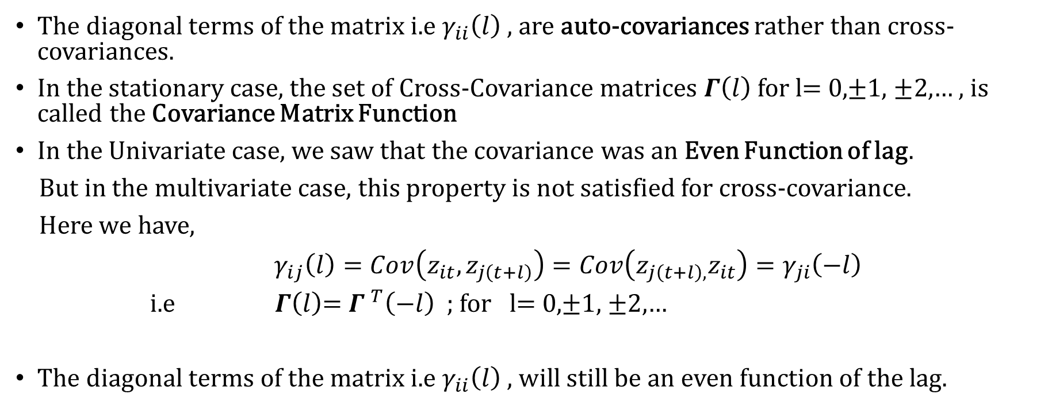
Properties of Cross-Covariance
The diagonal terms of the matrix i.e $γ_{ii}\left(l\right)$ , are auto-covariances rather than cross-covariances.
In the stationary case, the set of Cross-Covariance matrices $Γ\left(l\right)$ for l= 0,$±1,$ $±2,$… , is called the Covariance Matrix Function
In the Univariate case, we saw that the covariance was an Even Function of lag.
But in the multivariate case, this property is not satisfied for cross-covariance.
Here we have,
$γ_{ij}\left(l\right)=Cov\left(z_{it},z_{j\left(t+l\right)}\right)=Cov\left(z_{j\left(t+l\right),}z_{it}\right)=γ_{ji}\left(−l\right)$
i.e $Γ\left(l\right)$= ${Γ }^{T}\left(−l\right)$ ; for l= 0,$±1,$ $±2,$…
The diagonal terms of the matrix i.e $γ_{ii}\left(l\right)$ , will still be an even function of the lag.

Slide 12
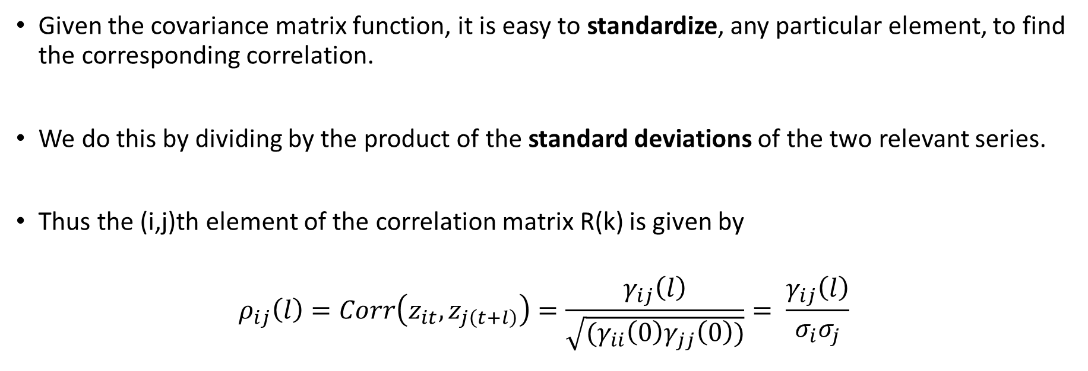
Cross-Correlation Matrix
Given the covariance matrix function, it is easy to standardize, any particular element, to find the corresponding correlation.
We do this by dividing by the product of the standard deviations of the two relevant series.
Thus the (i,j)th element of the correlation matrix R(k) is given by
$$ρ_{ij}\left(l\right)=Corr\left(z_{it},z_{j\left(t+l\right)}\right)=\frac{γ_{ij}\left(l\right)}{\sqrt{(γ_{ii}\left(0\right)γ_{jj}\left(0\right))}}= \frac{γ_{ij}\left(l\right)}{σ_{i}σ_{j}}$$

Slide 13
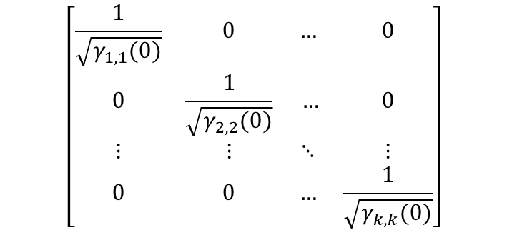
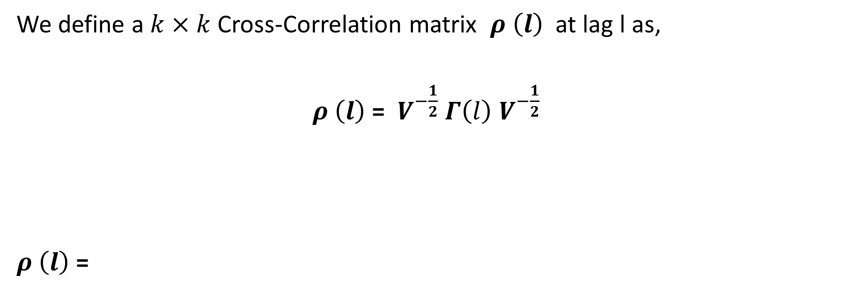
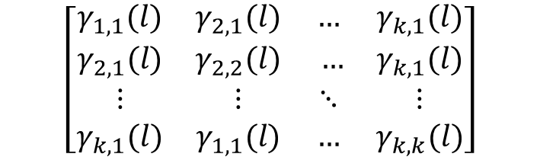
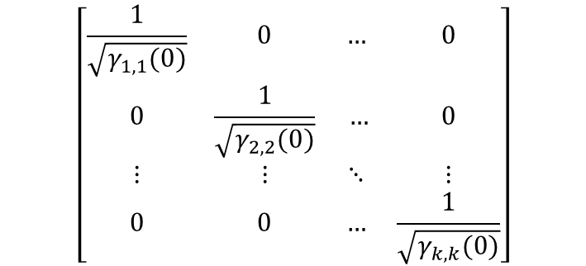
We define a $k×k$ Cross-Correlation matrix $ρ \left(l\right)$ at lag l as,
$ρ \left(l\right)$ = $V^{−\frac{1}{2}}$ $Γ\left(l\right)$ $V^{−\frac{1}{2}}$
$ρ \left(l\right)$ =
$$\left[\begin{matrix}\frac{1}{\sqrt{γ_{1,1}(0)}} & 0 & … & 0 \\ 0 & \frac{1}{\sqrt{γ_{2,2}(0)}} & … & 0 \\ ⋮ & ⋮ & ⋱ & ⋮ \\ 0 & 0 & … & \frac{1}{\sqrt{γ_{k,k}(0)}}\end{matrix}\right]$$
$$\left[\begin{matrix}\frac{1}{\sqrt{γ_{1,1}(0)}} & 0 & … & 0 \\ 0 & \frac{1}{\sqrt{γ_{2,2}(0)}} & … & 0 \\ ⋮ & ⋮ & ⋱ & ⋮ \\ 0 & 0 & … & \frac{1}{\sqrt{γ_{k,k}(0)}}\end{matrix}\right]$$
$$\left[\begin{matrix}γ_{1,1}(l) & γ_{2,1}(l) & … & γ_{k,1}(l) \\ γ_{2,1}(l) & γ_{2,2}(l) & … & γ_{k,1}(l) \\ ⋮ & ⋮ & ⋱ & ⋮ \\ γ_{k,1}(l) & γ_{1,1}(l) & … & γ_{k,k}(l)\end{matrix}\right]$$

Slide 14
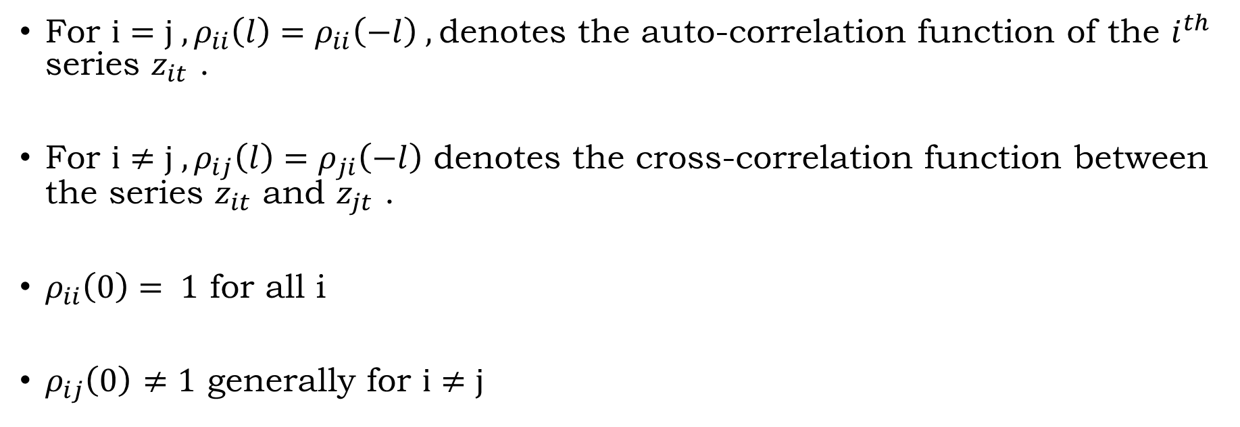
Properties of Cross Correlation
For $i=j , ρ_{ii}\left(l\right)=ρ_{ii}\left(−l\right) ,$denotes the auto-correlation function of the $i^{th}$ series $z_{it}$ .
For $i≠j , ρ_{ij}\left(l\right)=ρ_{ji}\left(−l\right)$ denotes the cross-correlation function between the series $z_{it}$ and $z_{jt}$ .
$ρ_{ii}\left(0\right)= 1$ for all i
$ρ_{ij}\left(0\right)$ $≠1$ generally for $i≠j$

Slide 15
VECTOR AUTOREGRESSIVE MODEL
A Vector Autoregressive (VAR) model is a multivariate time series model that captures the dynamic relationship among multiple variables. In a VAR model, each variable is regressed on its own lagged values and the lagged values of all other variables in the system.
A vector autoregressive model of order p, or VAR(p) model, is defined as
Φ(B)Z_{t} = a_{t}
Where Φ(B) = I − Φ₁B − Φ₂B² − ⋯ − Φ_{p}B^{p}, Φ_{i} is a k × k parameter matrix, and a_{t} is
a white noise sequence with mean 0 and covariance matrix Σ.
The parameters can be estimated through OLS estimation, maximum likelihood estimation and Yule-Walker equations.
Analogous to AR(p) process.

Slide 16

Assumptions of var model:
Linearity:
Stationarity
No Multicollinearity
No Endogeneity
No Serial Correlation

Slide 17
Advantages and limitations
ADVANTAGES:
Flexibility
Robust
Prediction power
LIMITATIONS;
Complex computations
Overfitting
Difficult to interpret

Slide 18
APPLICATIONS OF VAR MODEL
Macroeconomic forecasting: VAR models can be used to forecast macroeconomic variables such as GDP, inflation, and unemployment. By modeling the relationships between these variables, VAR models can provide useful insights into the behavior of the economy.
Finance: VAR models are commonly used in finance to model the relationships between financial variables such as stock prices, interest rates, and exchange rates. By using a VAR model, analysts can identify the key factors driving changes in these variables.

Slide 19
APPLICATIONS OF MULTIVARIATE TIME SERIES
Financial forecasting: Multivariate time series analysis can be used to forecast stock prices, exchange rates, and other financial variables by analysing the interactions between them.
Climate modeling: Multivariate time series analysis can be used to model the behavior of the earth’s climate over time, incorporating data on temperature, precipitation, atmospheric pressure, and other relevant factors.
Quality control: Multivariate time series analysis can be used to monitor and control the quality of production processes in manufacturing by analysing multiple variables such as temperature, pressure, and humidity.
Engineering: Multivariate time series analysis can be used to predict equipment failure and optimize maintenance schedules by analysing multiple variables such as temperature, vibration, and pressure.
Marketing: Multivariate time series analysis can be used to forecast sales and consumer behavior, taking into account factors such as advertising spending, promotional activities, and consumer sentiment.

